Slide 1
Fake News Detection Using BERT Model Team Members: Abhishek Chaudhary THA076BCT003 Adhip Bhattarai THA076BCT004 Kshitiz Poudel THA076BCT018 Nandan Singh THA076BCT020 Under the supervision of Kshetraphal Bohara Department Of Electronics and Computer Engineering Institute of Engineering, Thapathali Campus 10th March, 2023

Slide 2
OUTLINE
Motivation
Introduction
Problem Statement & Objectives
Scope of Project
Project Applications
Methodology
Results
Analysis/Discussion of Results
Future Enhancements
Conclusion
References

Slide 3
MOTIVATION
Increase of fake news in social media
Use of fake news for political gain in election of Nepal.
Lack of such tools for Nepali language.

Slide 4
INTRODUCTION
Fake news is a digital-age challenge.
Fake news detection to mitigate fake news effects.
Deployment of two methods.
Detection of such news early can minimize spreading.

Slide 5
PROBLEM STATEMENT & OBJECTIVES
Problem Statement:
Spread of false information on social media
Lack of platform to identify Nepali text-based news
Objectives:
To distinguish real and fake Nepali news through source checking and BERT
To implement the system into use on the web and make it broadly accessible.

Slide 6
SCOPE OF PROJECT
Nepali text-based fake news detector
Fake news detection using source-checking and BERT model
Design of web app
Translation of English fake news to Nepali

Slide 7
PROJECT APPLICATIONS
Media and Journalism
Political campaign
Business

Slide 8
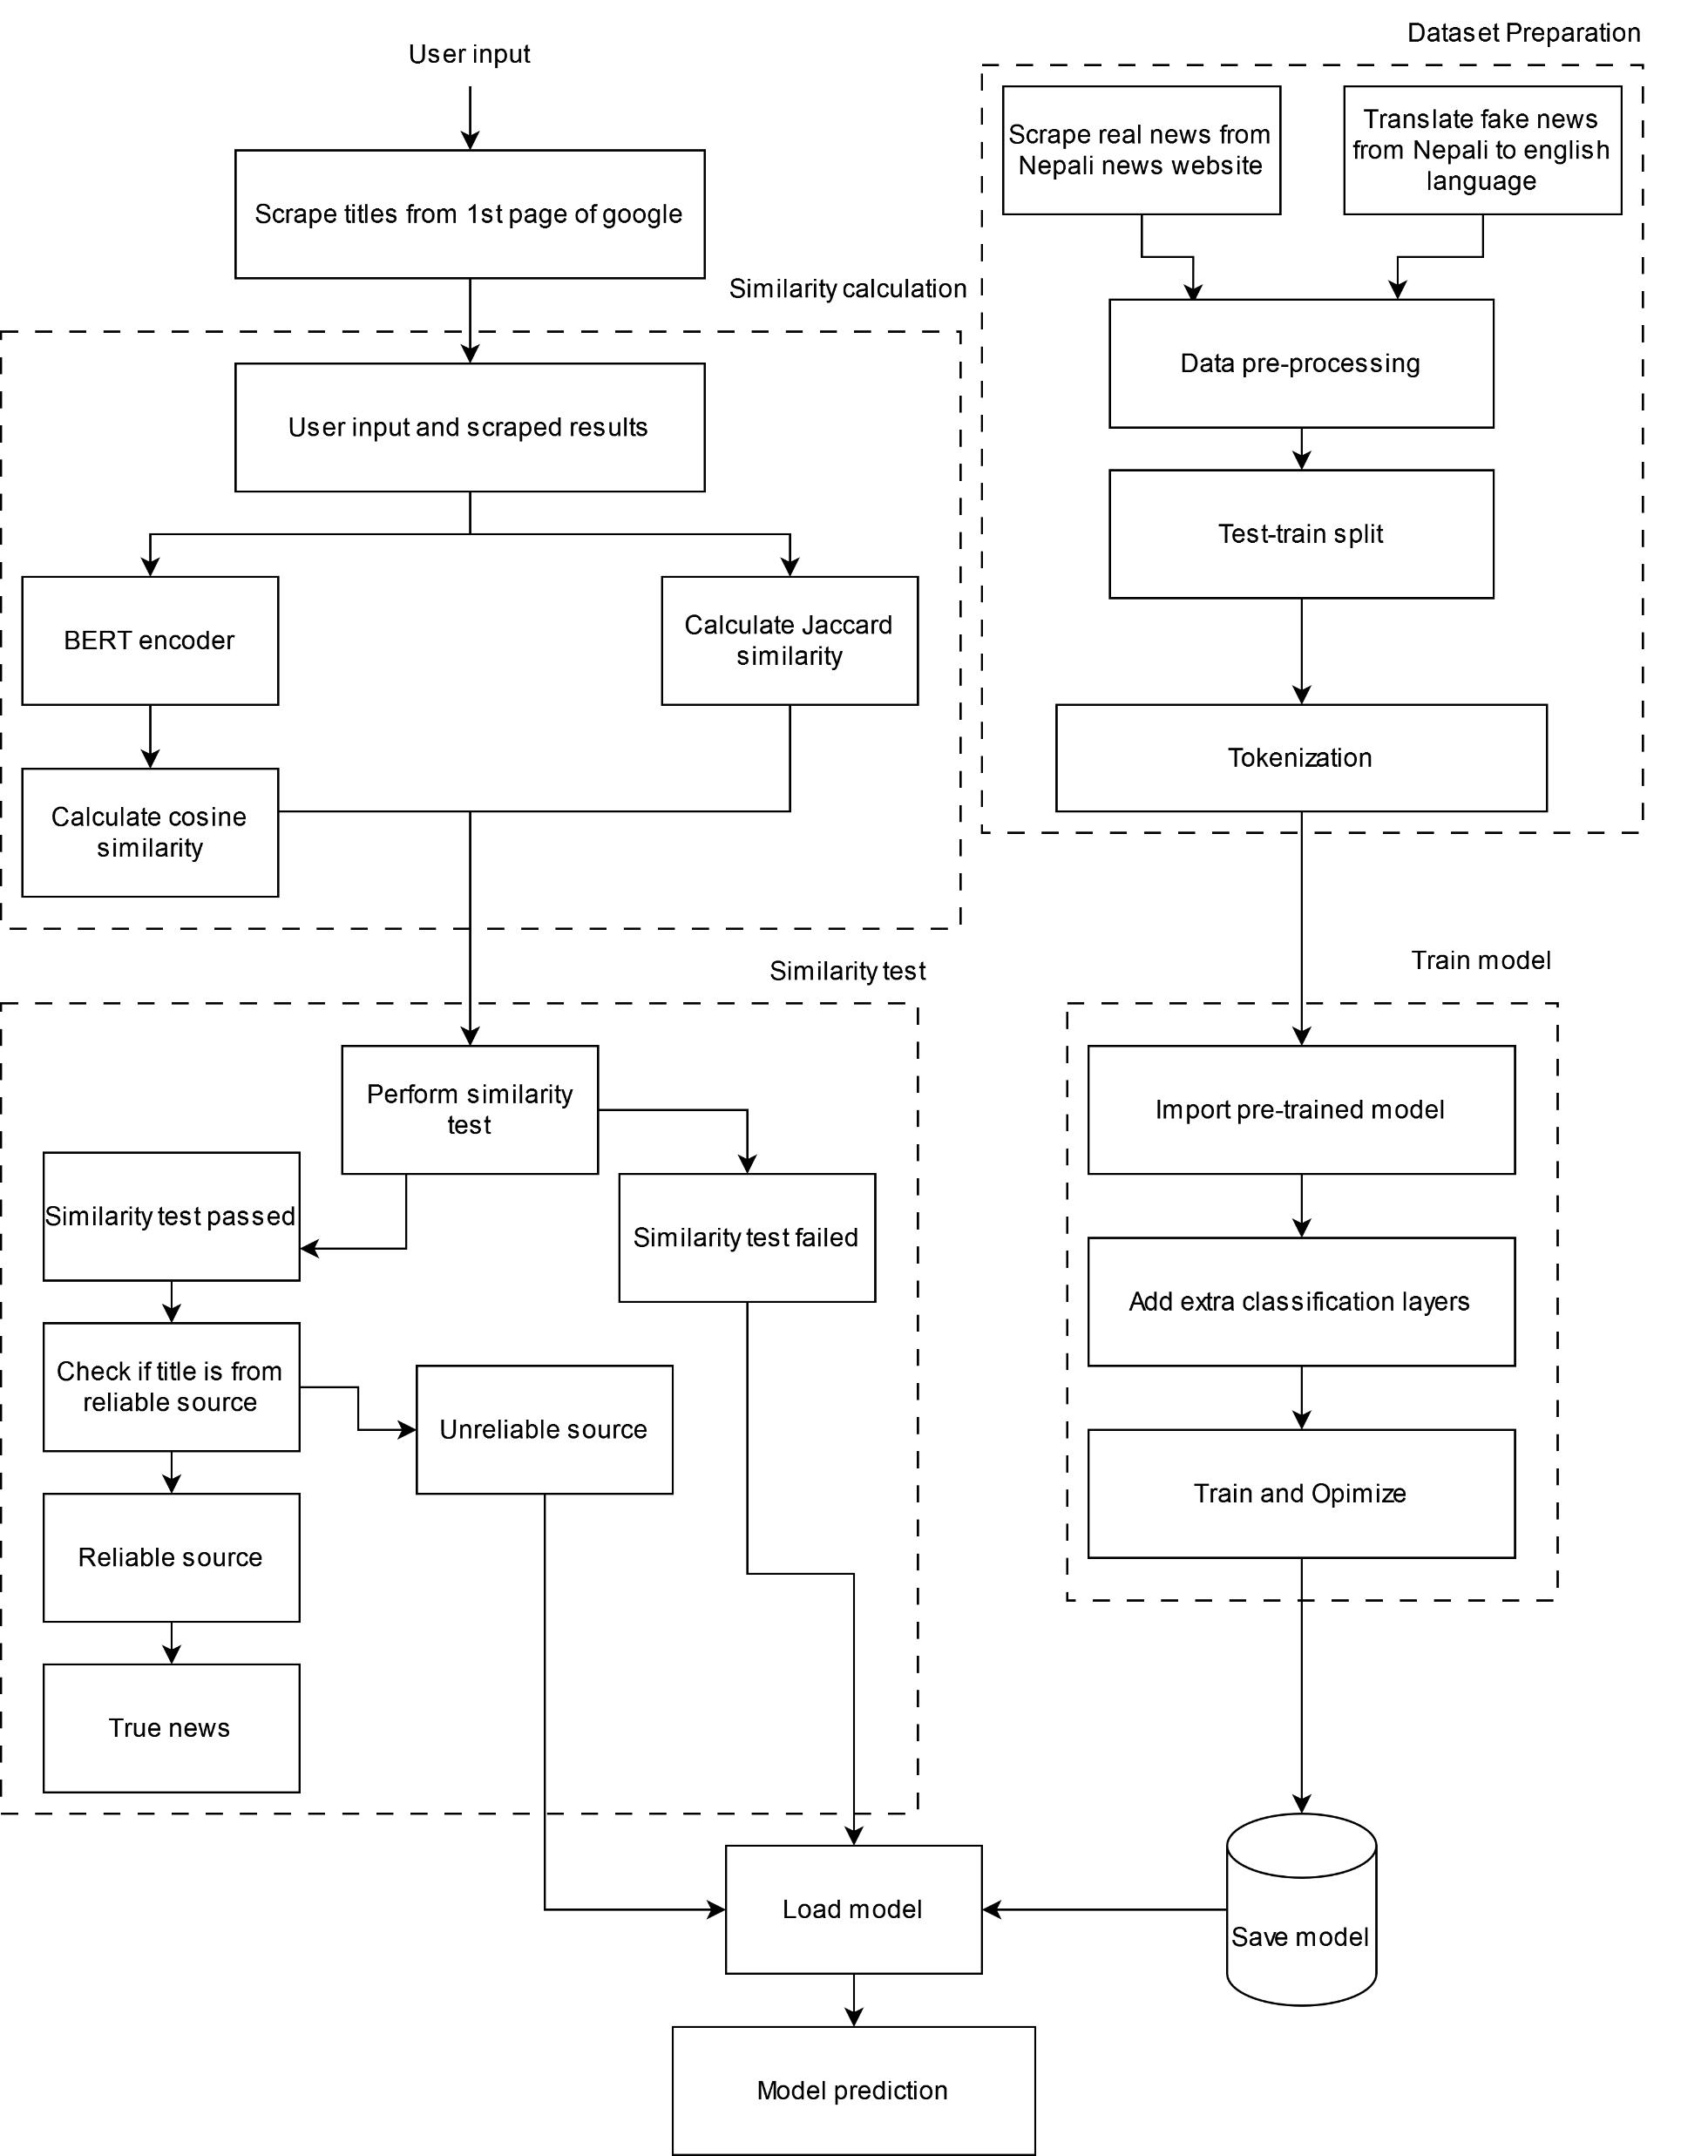
Methodology
Fig: Block diagram

Slide 9
Methodology
Two methods:
Source Checking by web scraping
BERT model

Slide 10
Methodology
1. Source checking by Web Scraping
Make a list of trusted websites
Search the title provided by the user
Scrape titles and URLs from the web
Find Jaccard Similarity between input and Searched title
Pass both titles to the BERT encoder
Calculate cosine similarity between two vectors

Slide 11


Methodology
Cosine similarity
Jaccard Similarity
A – text 1
B – text 2

Slide 12
Methodology
Two titles are similar if:
Cosine > 0.7
Jaccard > 0.5
Real if similar titles are from trusted sources

Slide 13
Methodology
2. BERT Model
Data Collection:
Real news scraped from Nepali trusted online news sites (9514)
Fake news (9514) translation from English to Nepali (obtained from Kaggle LIAR dataset)

Slide 14
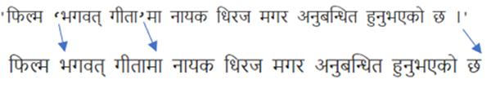
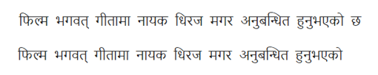
Methodology
Data Pre-processing
Data labeling: 0-Real, 1-fake
Data cleaning: remove unnecessary columns, null values
Remove punctuation
Remove Stop words

Slide 15
Methodology
Test train split - 80% train, 20% test
Tokenization
Separate text into smallest units in vocabulary
Special tokens – CLS, SEP, UNK
Input Embedding
Map each token to a vector
Add positional encoding to each vector
Pass resulting vector as input to encoder layer
Encoder generates contextualized embedding vectors.

Slide 16
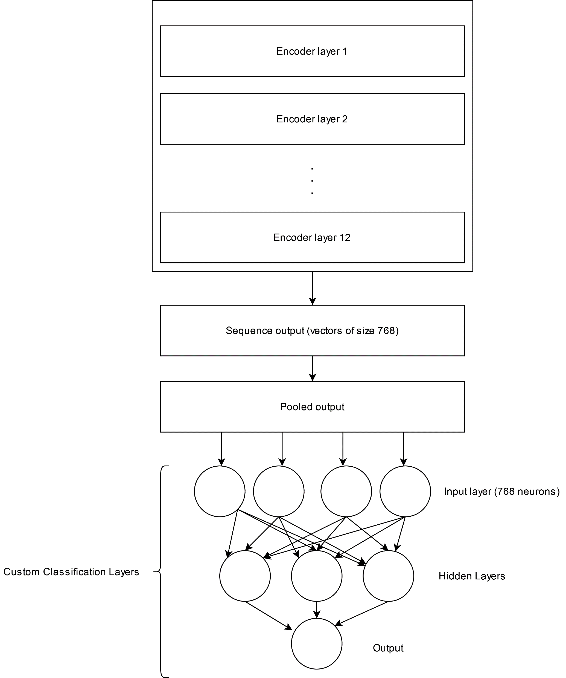
Methodology
Fig: Model Architecture

Slide 17
Methodology
Model Training
Loss function = Binary cross-entropy
Optimizer = Adam
Learning rate = 1e-3
Batch size = 32
Epoch =30
Use of Dropout and L2 regularization
Performance metrics evaluation
Precision, accuracy, recall, F1-score

Slide 18
Methodology
Deploy Model on website
Frontend – HTML, CSS
Backend – Flask

Slide 19
Results
Loss vs Epoch Graph and Accuracy vs Epoch graph:

Slide 20
Results
Confusion Matrix:

Slide 21
Results
Evaluation Metrics

Slide 22
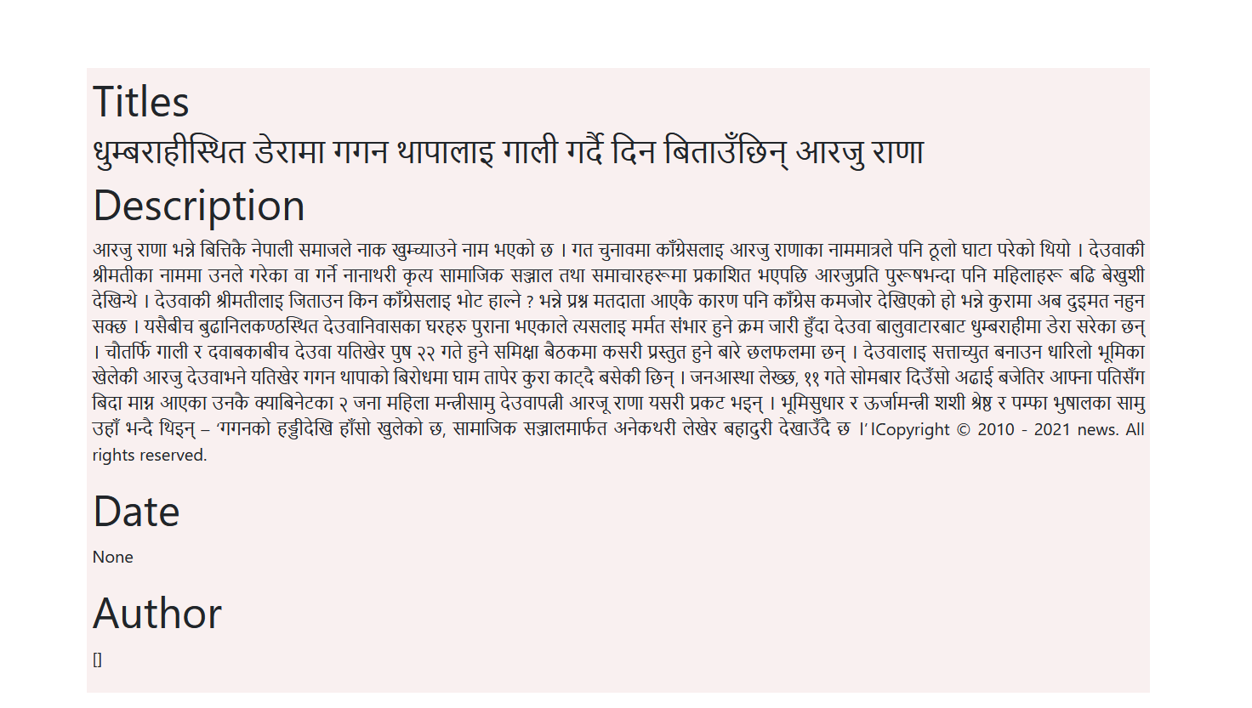

Results
Fig: Homepage of website

Slide 23
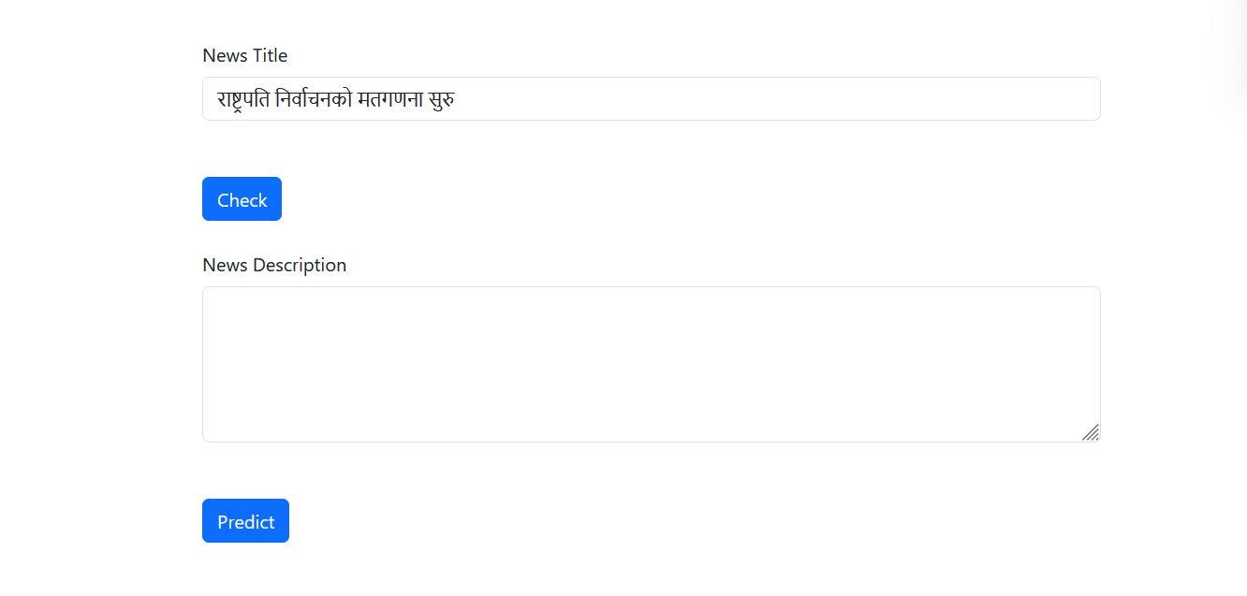
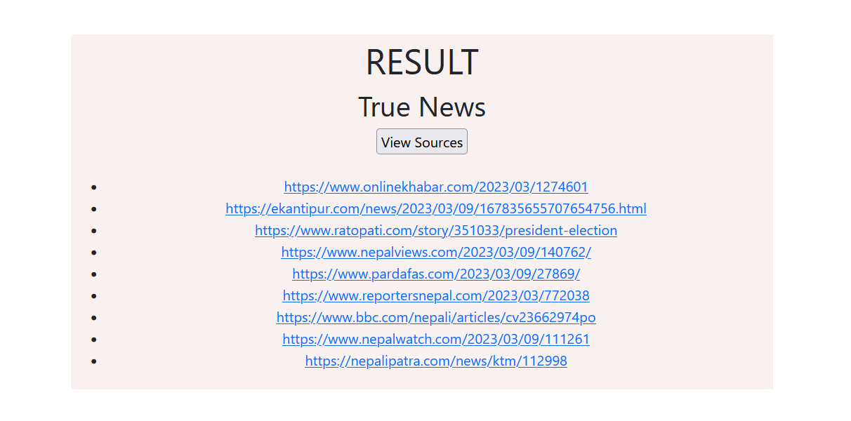
Results
Fig: Source Checking

Slide 24
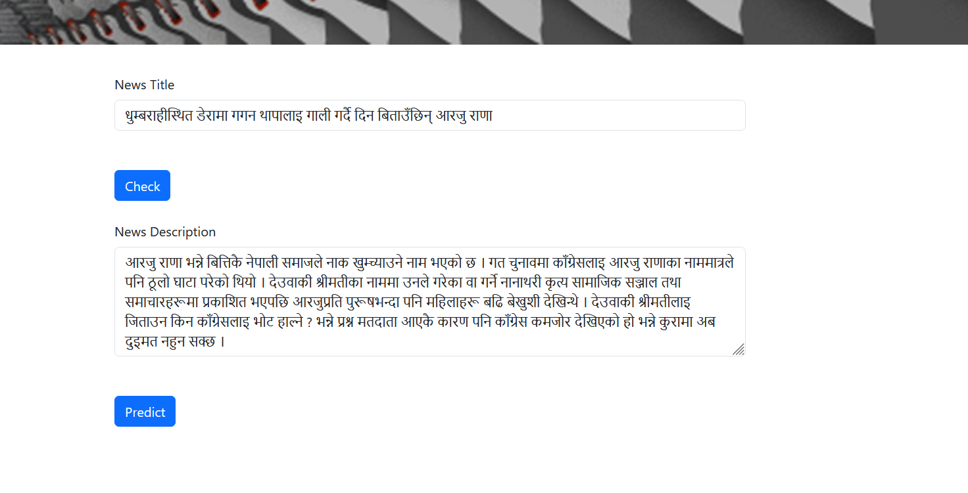
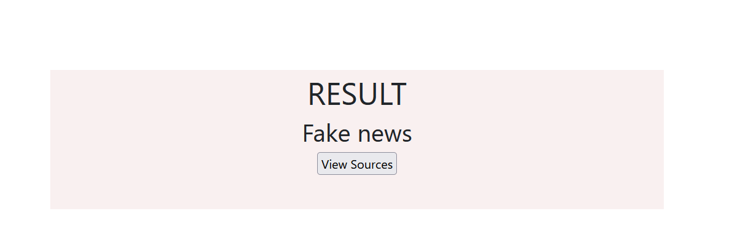
Results
Fig: BERT prediction

Slide 25
Analysis/Discussion on Result
Source checking method is efficient in predicting true news, if it is from credible Nepali news sources.
Reasons for inefficient prediction of actual fake news by BERT model:
Lack of fake Nepali news dataset, so translated dataset is used
BERT base model can only process 512 tokens, so very large news descriptions can be wrongly predicted

Slide 26
Future Enhancements
Address language nuances
Training model on fake Nepali news dataset rather than translated fake news
Addition of images, videos along with text for prediction

Slide 27
Conclusion
Used source checking and BERT model to predict news truthiness.
Source checking method verifies if news is from credible sources.
BERT model predicts truthiness based on semantics of news.
Achieved F1-score of 0.96 for true and fake test dataset.
Using real Nepali fake news can enhance BERT’s fake news prediction.

Slide 28
References
[1] C. Elliott, "Forbes," 21 February 2019. [Online]. Available: https://www.forbes.com/sites/christopherelliott/2019/02/21/these-are-the-real-fake-news-sites/?sh=2554c7c23c3e.
[2] D. Adhikari, "Onlinekhabar," 13 December 2022. [Online]. Available: https://english.onlinekhabar.com/misinformation-elections-nepal.html.
[3] L. Breiman and A. Cutler, Random Forests, 2001.
[4] J. Devlin, M.-W. Chang, K. Lee and K. Toutanova, "BERT: Pre-training of Deep Bidirectional Transformers for Language Understanding," Google AI Language, 2019.
[5] K. Stahl, "Fake news detection in social media," 2018.
[6] J. Zhang, B. Dong and P. S. Yu, "FAKEDETECTOR: Effective Fake News Detection," 2019.
[7] G. K, S. Ramani and M. K. S, "Identification of Fake News through SVM and Random Forest," 2020.

Slide 29
References
[8] T. Yesugade, S. Kokate, S. Patil, R. Varma and S. Pawar, "Fake News Detection using LSTM," International Research Journal of Engineering and Technology (IRJET), 2021.
[9] U. Sharma, S. Saran and S. M. Patil, "Fake News Detection using Machine Learning Algorithms," International Journal of Engineering Research & Technology (IJERT), 2021.
[10] I. K. Sastrawan, I. Bayupati and D. M. Sri, "Detection of fake news using deep learning CNN–RNN based methods," 2021.
[11] M. Farokhian, V. Rafe and H. Veisi, "Fake news detection using parallel BERT deep neural networks," 2022.
[12] S. R. Dam, S. P. Panday and T. B. Thapa, "Detecting Clickbaits on Nepali News using SVM and RF," 2021.
[13] N. Shakya and P. Poudyal, "Detection of fake news using deep neural networks," Kathmandu University Journal of Science, Engineering and Technology,, vol. 16, no. 2, 2022.
[14] "Tensorflow," [Online]. Available: https://www.tensorflow.org/text/tutorials/bert_glue.

